Slide 1

Advance HTML
Final Project
Title:Restaurant
Name:Inderpreet Singh(3690)
Name:Jaskaran Singh(3698)
April 2020
1

Slide 2
Advanced HTML
Restaurant is a business that prepares and serves food and drinks to customers. Meals are generally served and eaten on the premises, but many restaurants also offer take-out and food delivery services.
Our Project that represents:Restaurant website and there is a welcome page,Gallery,Menu,About,Contact Html Pages with their Css styles.
Welcome Page that contians HTML and CSS:
HTML Code:
<img src="images/logo.png" class="logo">
<div class="header-right">
<a href="gallery.html"><img src="images/gallery.png" alt="fb" >Gallery</a>
<a href="Menu.html"><img src="images/Menu.png" alt="fb" >Menu</a>
<a href="about.html"><img src="images/about.png" alt="fb">About</a>
<a href="contact.html"><img src="images/contact.png" alt="fb">Contact</a>
Anchor tag is used for redirect the link and img tag is used for images.
CSS;
April 2020
Title:
1

Slide 3

Advanced HTML
Footer html:
<img src="images/logo.png">
<p class="footer-links">
<a href="gallery.html">Gallery</a>
|
<a href="Menu.html">Menu</a>
|
<a href="about.html">About</a>
|
<a href="contact.html">Contact</a>
</p>
CSS for header and footer: .header { overflow: hidden; background-color: #f1f1f1; padding: 20px 10px;height: 80px;} .header a { float: left;color: black; text-align: center; padding: 5px 15px 15px 15px;text-decoration: none;font-size: 0.8cm; margin-top: 20px; line-height: 25px; border-radius: 4px; } .header img.logo { width: 160px;height: 80px;}.header a:hover {background-color: #ddd;color: goldenrod }
April 2020
1
Title:

Slide 4
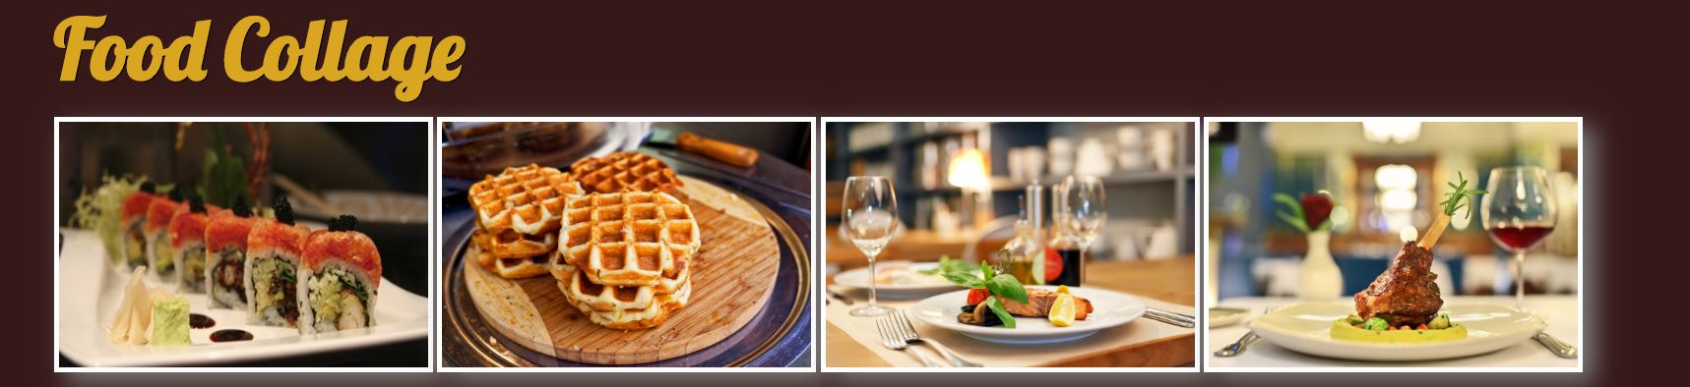
Advanced HTML
.footer-part{background-color: #f1f1f1;box-sizing: border-box;width: 100%;text-align: left;font: bold 16px sans-serif;padding: 30px 30px 0 30px;}.footer-left,.footer-center,.footer-right{display: inline-block;vertical-align: top;}
Gallery page:In this,there is a food collage of different pictures.
<section class="pic_gallery"><h2>Food Collage</h2><img src="images/1.jpg" alt="photo"><img src="images/2.jpg" alt="photo">
…
Css Code:section { width: auto;height: 800px; margin-left: 120px;}.pic_gallery>img {width: 300px;height: 200px; margin: 0 auto margin-top: 1%; filter: drop-shadow(10px 8px 10px gray);filter: scale(1.02, 1.02);
border: 4px solid white;}h2 {color: goldenrod;margin: 0 auto;text-shadow: 1px 1px black;font-size: 1.8cm;}
April 2020
1
Title:

Slide 5
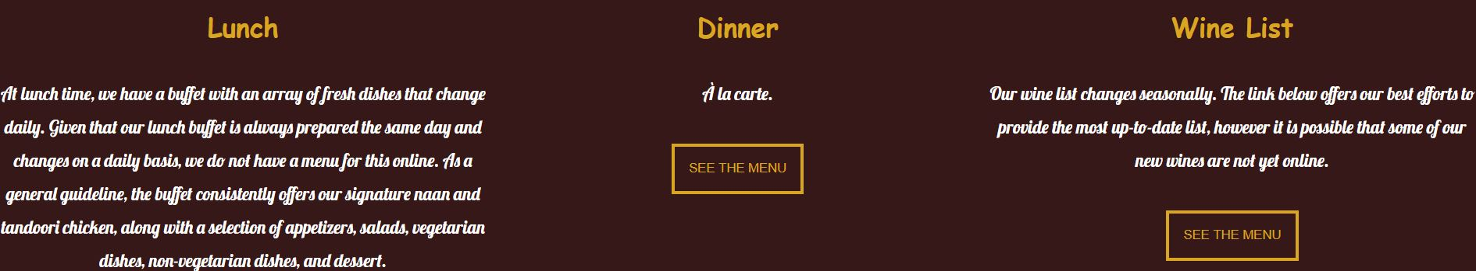
Advanced HTML
Menu Page:In this page,there is a menu of lunch,dinner and wine list.
In Html code,we used a main tag which holds the menu of the restaurant,inside main tag there is a aside and section tag which has their own properties.
Css Code:section {width: auto;height: 800px;margin-left: 120px;}.pic_gallery>img { width: 300px;height: 200px;margin: 0 auto;margin-top: 1%;filter: drop-shadow(10px 8px 10px gray);filter: scale(1.02, 1.02);border: 4px solid white;}h2 {color: goldenrod;
margin: 0 auto;text-shadow: 1px 1px black;font-size: 1.8cm;}
April 2020
1
Title:

Slide 6
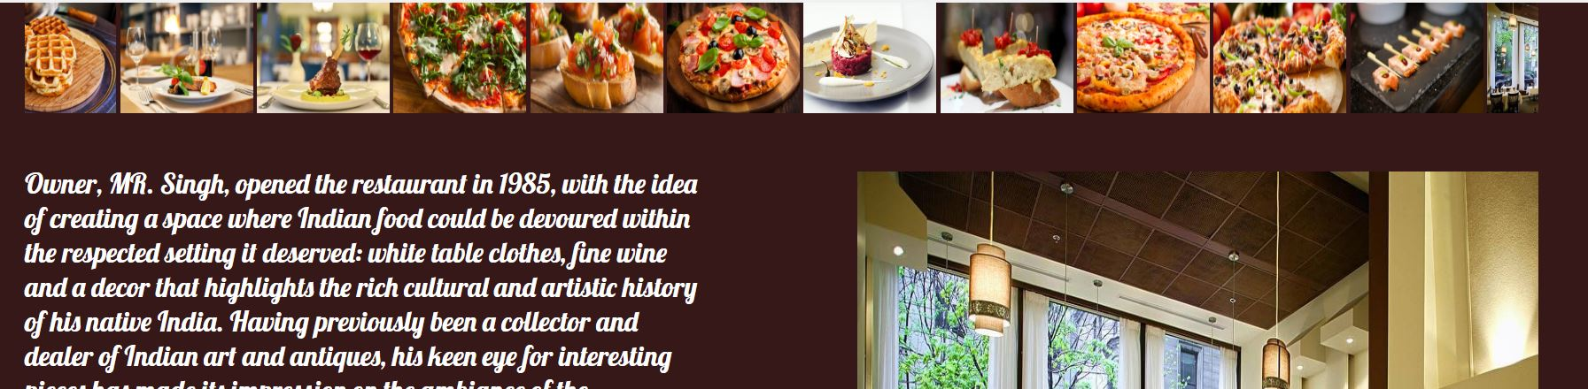
Advanced HTML
About Us Page:In this, there is a histroy of the restaurant,marquee tag and interior picture of the restaurant.
Html code:<marquee behavior="scroll" direction="left"> <img src="images/1.jpg" width="120px" height="100px" alt="Natural">
This tag is use to insert a scrolling area of text,images.
<p>Owner, MR. Singh, opened the restaurant in 1985, with the idea of creating a space</p>
This tag is use to represents a paragraph.
Css Code:section>article{ width: 45%;height: 590px;font-size: 25px;margin-top: 40px;
float:left;}section>article>p{color:white;}section>aside{width: 45%;height: 590px;margin-top: 45px;float:right;}section>aside>img{width:100%;height: 590px;}
April 2020
1
Title:

Slide 7
Advanced HTML
Contact us Page:This page contains a form,Google Map to contact regarding any query with providing a personal details.
Html page:
<article class="form"><form action="registration"><fieldset><legend>Your Information</legend><label for="lastName">Last Name</label><input type="text" id="lastName" placeholder="Last Name" required="required" maxlength="50" autofocus /><label for="firstName">First Name</label><input type="text" id="firstName" name="firstName" placeholder="First Name" required="required" maxlength="50" />
Article tag is self-contained content.
Form tag is used for creating a form of user input and its contains textfields,checkboxs and more.
Legend tag is used to designate a caption for the fieldset tag.
Label tag is used to toggles the control of mouse.
Input tag is used for acceptance of user-input data of various types on a website.
April 2020
1
Title:

Slide 8
Advanced HTML
<iframe src="https://www.google.com/maps/embed width="100%" height="395px" frameborder="0" style="border:0;" allowfullscreen="" aria-hidden="false" tabindex="0"></iframe>
Iframe tag is defines a region within the document in which browser can display a seperate document,including scrollbars and borders.
Css Code:fieldset{background-color: #ddd;color: goldenrod;}legend {color: goldenrod;
font-size: 20px;background-color: #361818;padding: 5px;margin-left: 20px;}label { width: 35%;display: inline-block;margin-top: 20px;font-size: 19px;text-align: right;margin-right: 15px;}input[type=submit] {margin-left: 45%;color: goldenrod;background-color: #361818;width: 80px;height: 40px;margin-top: 5px;}
April 2020
1
Title:

Slide 9
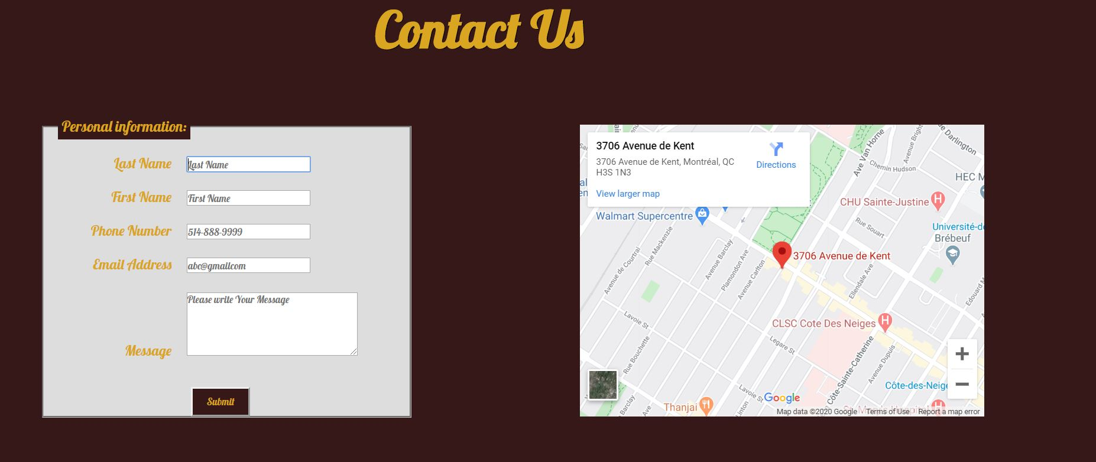
Advanced HTML
We also used three media query which is use to make a responsive website according to different devices resolution.
Larger than 992px(for medium devices)
Larger than 768px(for small devices,tablets)
Smaller than or equal to 600px(smartphones)
April 2020
1
Title:

Slide 10

Advanced HTML
April 2020
<number>
Title:

